Slide 1
Demand forecasting
101
Lummetry.AI

Slide 2
Purpose and definitions
Historical sales data is used to develop an estimate of an expected forecast of customer demand for services or products
The estimates impact critical business (future) assumptions like turnover, profit margins, cash flow, operational expenditure, capital expenditure, risk assessment and mitigation plans, capacity planning and other

Slide 3
Purpose and definitions
Short (1 to 6 months) as well as mid and long term (6+ months) estimates are employed for various purposes:
pre-building,
make-to-stock,
make-to-order,
contract manufacturing,
supply planning,
network balancing,
etc

Slide 4
Demand forecasting techniques
Two options:
Qualitative Research - human focused research on specific product/service or meta-product
Quantitative Research - statistical and usually automatic (computer aided)

Slide 5
Demand forecasting techniques
Qualitative approach - use market research experts, sales teams or average purchase/operations opinions:
High granularity
Long-term
Biased towards specific products
Focus on expert individual expertise areas

Slide 6
Demand forecasting quantitative techniques
Quantitative approach that use data and apply statistical methods:
Static forecasting: average of historical data based on business relevant historical data
Trend projection: use advanced statistical methods to project trends: moving averages and least-square methods
Barometric (econometric) forecasting: use macro-economic models to project high-granularity and potential long-term forecasts (similar and closely related to qualitative analysis but based on macroeconomic data)

Slide 7
Most usual approaches
Simple static forecasting by averaging historical data
Advanced static forecasting with weighted averages (eg: combine average weekly sales in last month with average weekly sales in last year)
Advanced static forecasting with weighted averages and re-adjusted with experts opinion: after computing static forecast a purchase/sales expert adjusts based on personal opinion (or bias)

Slide 8
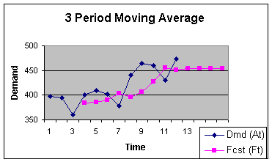
Most usual approaches
Trend projection based on moving averages
Picture courtesy of fcgu.edu

Slide 9
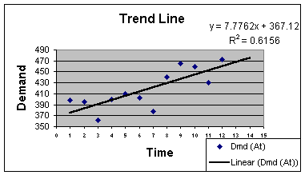
Most usual approaches
Trend projection based on least square (basic machine learning)
Picture courtesy of fcgu.edu

Slide 10
Classic demand forecasting pros and cons
The logic is simple so the business user relates to the logic of the predictions
Almost impossible to generate patterns unless the trend is extremely predictable (such as a weekend-only sold item)

Slide 11
More advanced approaches
Expensive to build and maintain
Explainability is (almost) zero - usually seen as “black-boxes”
Use advanced models and ingest exogenous data (such as promotions or weather) and can be used for A/B testing
Almost invariantly will best the classic approaches for any kind of use-case

Slide 12
Wait, better? How do I know who’s better?
Start from your data - automatic or manual analysis
Understand your business process objectives and requirements including but not limited to:
Final objective (replenishment, marketing sensitivity simulation, etc)
Aggregation levels (day, week, etc)
Endogen (date, time, quantity sold yesterday, etc) and exogen variables (weather, promotion)
etc

Slide 13
Wait, better? How do I know who’s better?
2. If you have already predictions then you could skip next step...
.. however if you don’t have predictions or a existing forecasting model you have to analyze what fits you best:
Multi-level averages (most likely usually implemented.. skip to next step then)
Linear models (most likely best candidate)
Moving averages
Other

Slide 14
Wait, better? How do I know who’s better?
3. Adopt the explainable approaches that you relate with (even all)?
Usually medium and large business are using statistical based heuristics that they already employed in previous years/periods

Slide 15
Wait, better? How do I know who’s better?
4. Establish a test base - what to consider history and what is (known) future
If the backlog data (history) is too long it might not be relevant to current trends (see pre and post COVID-19)
If the backlog data is too short then some methods are inapplicable (eg. weighted averages of similar 30 days period for past 2 years with last 3 months worth of trend data will not work if you only have 200 days backlog)
Last but not least: select what means “past” (real data that is available to all methods) and what is designated as “future” (real historical data that is kept private)

Slide 16
Wait, better? How do I know who’s better?
5. Apply your adopted explainable approach and generate forecasts
At this moment you have a couple of options:
Get data from ERP systems if it already exists for “future” historical data (not the real backlog but rather the forecasts generated at that time such as order quantities)
Or re-run your heuristics or models using “past” data and generate “future” values

Slide 17
Wait, better? How do I know who’s better?
6. Use the advanced techniques to generate advanced forecasts
Feed the “past” in the advanced models (Deep Learning, etc) and obtain the predicted “future”
Maybe get several “opinions” (multiple models) each with its pros and cons such as speed vs accuracy

Slide 18
Wait, better? How do I know who’s better?
7. Compare both classic and advanced results vs reality and judge.
How to compare predictions from the two worlds:
Step by step including average error and visual comparison
Step by step can mean hour by hour, day by day, week by week
Analyse each autoregressive step and compare with baseline as well as reality
Visually compare by overlapping predictive steps of both models with reality
Almost impossible to “guess” the right answer

Slide 19
Wait, better? How do I know who’s better?
7. Compare both classic and advanced results vs reality and judge.
How to compare predictions from the two worlds:
Period based amount comparison and error measurement
Useful when step prediction is not that important but the aggregated one is vital for business
Aggregate all predicted steps and analyse the result vs baseline vs reality
More prone to miss-judgments than step-by-step and requires multiple tests

Slide 20
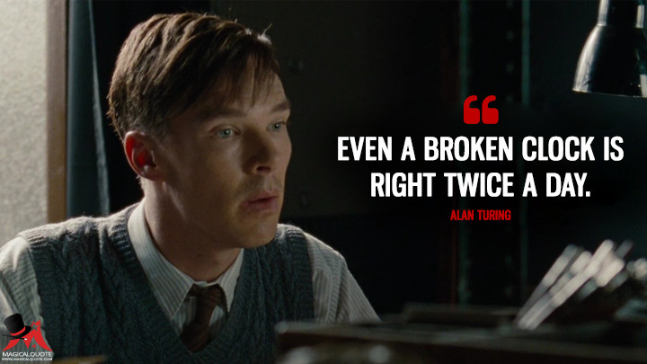
Setting the right expectations
Between two extremes:
glorified random number generators
vs
truly intelligent models

Slide 21
Setting the right expectations
Critical AI failure in 2022:
Data drift
Concept drift
Changing requirements

Slide 22
Setting the right expectations
Critical AI failure in 2022 - Data drift
The model was trained on a certain distribution of inputs, but this distribution changes over time. Example we trained a model to estimate demand for electricity from historical data, but climate change is causing unprecedented changes to weather, so the model’s accuracy degrades. See COVID.

Slide 23
Setting the right expectations
Critical AI failure in 2022 - Concept drift
The model was trained to learn an x->y mapping such as to predict the time to unload a automatic delivery box based on data, location, sex and age of customer, but the statistical relationship between x and y changes, so the same input x now demands a different prediction y - such as we need the actual time of day when the customer will unload. For example, a model that predicts housing prices based on square footage will lose accuracy as inflation causes prices to rise.

Slide 24
Setting the right expectations
Critical AI failure in 2022 - Changing requirements
The model was built to perform a particular task, but the product team decides to modify its capabilities. For instance, a model detects construction workers who wander into a dangerous area without a hard hat for more than 5 seconds. But safety requirements change, and now it must flag hatless workers who enter the area for more than 3 seconds. (This issue sometimes manifests as concept drift, but I put it in a different category because it’s often driven by changes in the product specification rather than changes in the world.)

Slide 25
Measuring the impact

